Slide 1


After the 2021 Local Government Elections:
A fresh outlook on local environmental sustainability in South Africa
WORKSHOP
22 November 2022
----------------------------
Pathways & Opportunities for Collaborative Municipal Service Delivery
Presenter: Krisdan Bezuidenhout
Email: 21312850@mynwu.ac.za

Slide 2


The instrument: “Municipal Public-Private Partnerships Regulations, 2005 (GN R309 in GG 27431 of 1 April 2005)”
What is a public-private partnership (PPP)?
Why are public-private partnership important?

Slide 3

Basis in SA Constitution
Public-Private Partnerships are implemented by way of procurement processes.
The primary piece of legislation that lays the regulatory foundation of public procurement is the Constitution.
Section 217, titled Procurement, provides insight into the constitutional requirements for PPP.

Slide 4
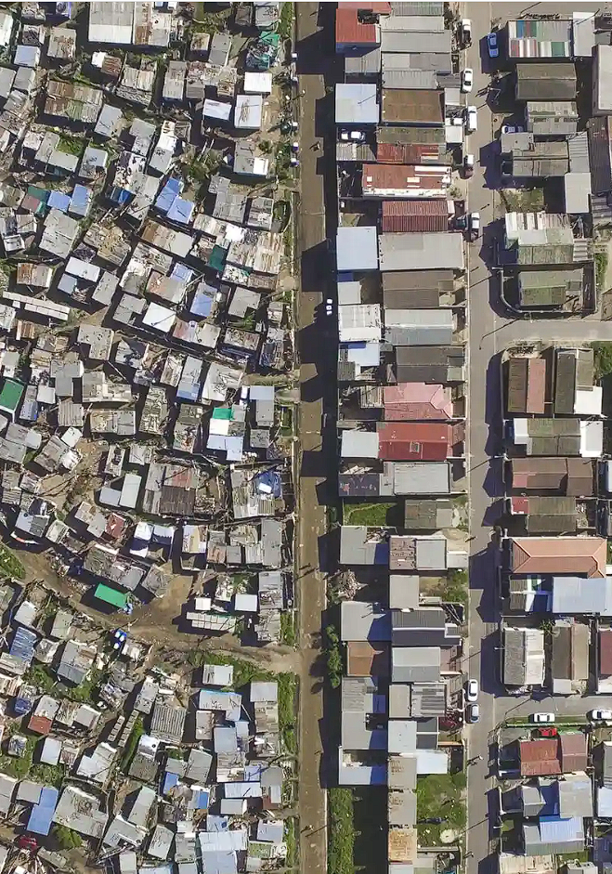
Basis in local government and other law (legislation)
Local Government: Municipal Systems Act 32 of 2000 Chapter 8 Section 76 – 84.
Local Government: Municipal Financial Management Act 56 of 2003 Chapter 11 Section 110 - 120.
Municipal Supply Chain Management Regulations (GN R868 in GG 27636 of 30 May 2005)
Municipal Service Delivery and PPP Guidelines, 2007

Slide 5

Instrument objectives
The Municipal Public-Private Partnership Regulations provide precise and detailed instructions for PPPs at the local government level.
The private sector supplements the growing need for development to bolster the capacity of local government to comply with its constitutional mandate to provide services.

Slide 6

Environmentally relevant features
The environmental relevance of these PPPs will differ from project to project; as such, they may have both positive and negative environmental implications.
Therefore it is vital to identify the environmental regulatory framework for a project to ensure legal compliance and the minimisation of adverse environmental impacts stemming from the project.

Slide 7

The responsible and accountable people
(The responsible persons below are as per the Municipal Service Delivery and PPP Guidelines, 2007)
Accounting officer
The Accounting officer is the municipal manager as provided for in Chapter 8 of the MFMA and is directly accountable for the efficient management of the municipal budget to achieve the municipality's public mandate. Moreover, only the Accounting officer can sign a PPP agreement, and the Accounting officer is responsible for its implementation.
Project officer
A person identified by the Accounting officer (within municipality or external) who is responsible for performing the duties set out in Section 116(2)(c)(i) and (ii) of the MFMA and any other duties or powers delegated by the accounting officer to him/her in terms of section 79 of the Act.
Adviser
A person or persons appointed in writing by an accounting officer of a municipality who has appropriate skills and experience to assist and advise the municipality to achieve informed decisions concerning the effective delivery of the defined service, including, if appropriate, the preparation and conclusion of a PPP agreement.

Slide 8
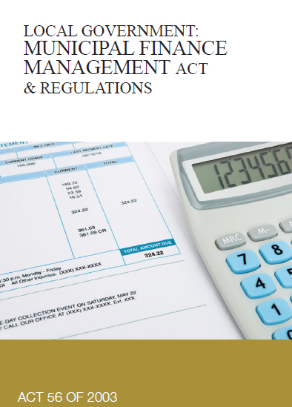
Requirements for development and review
Section 168(1)(d) of the MFMA
The Minister, acting with the concurrence of the Cabinet member responsible for local government, may make regulations or guidelines applicable to municipalities and municipal entities, regarding inter alia a framework regulating the financial commitments of municipalities and municipal entities in terms of public-­private partnership agreements.
Section 169 of the MFMA
Before regulations in terms of section 168 are promulgated, the Minister must consult the organised local government on the substance of those regulations; and publish the draft regulations in the Government Gazette for public comment. Regulations made in terms of section 168 must be submitted to Parliament for parliamentary scrutiny at least 30 days before their promulgation.
Section 170 of the MFMA
The National Treasury may, on good grounds, approve a departure from a treasury regulation or from any condition imposed in terms of this Act. Non­compliance with a regulation made in terms of section 168, or with a condition imposed by the National Treasury in terms of this Act, may on good grounds shown, be condoned by the Treasury.

Slide 9

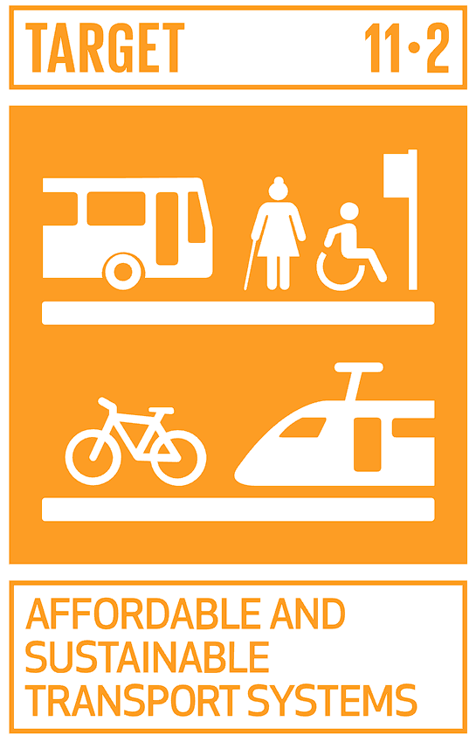

Linkages with Sustainable Development Goal 11
The implementation of PPPs has far-reaching implications for the overall sustainability of cities and human settlements. They can take any form and fit into any of the targets of SDG 11, such as:
Through the implementation of transportation-specific PPPs to make mobility in urban spaces more affordable, accessible and sustainable. Although transportation PPPs are underutilised in many African countries, the potential to contribute exists. The role and participation of taxi associations in this dialogue will be significant for the South African context.
In relation to disaster impact minimisation on GDP and human life. PPPs have the potential to deliver better value-for-money services as they are well-positioned to leverage expert knowledge and will be key considerations in disaster management activities at the sub-national level. Three categories of PPPs for disaster management can be distinguished: awareness and advocacy partnerships, disaster preparedness partnerships, and social investment partnerships.

Slide 10
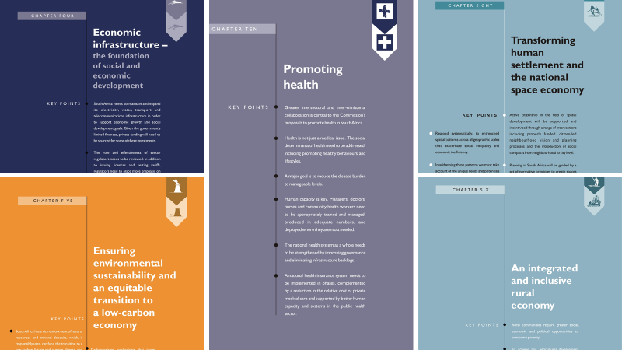

Linkages with SA’s National Development Plan (NDP)
The NDP makes reference to the use of PPP throughout the document and affirms that through inter alia building partnerships with the private sector, the country can create 11 million jobs by 2030.

Slide 11

Linkages with SA’s Integrated Urban Development Framework (IUDF)
Policy Lever 9: Sustainable finances
Cities and towns are supported by a fiscal framework that acknowledges the developmental potential and pressures of urban spaces, manage their finances effectively and efficiently, and access the necessary resources and partnerships for inclusive urban growth.
The document prescribes that when exploring alternative capital financing instruments, municipalities must consider public-private partnerships as a way of accelerating the delivery of critical infrastructure projects without incurring additional debt.

Slide 12
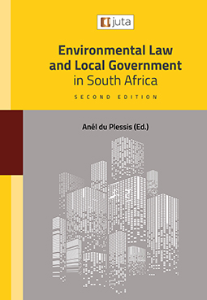
What do the scholars in this field suggest?
Wessels JA "Greening Sustainable Public Procurement" in Du Plessis A (ed) Environmental Law and Local Government in South Africa 2nd ed (Juta Cape Town 2021) 26: 1-41
The Municipal Systems Act requires that, when a municipality has to decide on a mechanism to provide a municipal service in the municipality, or to review any existing mechanism, 'it must first assess the direct and indirect costs and benefits associated with the project if the service is provided by the municipality through an internal mechanism, including expected effect on the environment and on human health, well-being and safety' Having done so, the municipality 'may decide on an appropriate internal mechanism to provide the service; or before it takes a decision on an appropriate mechanism, explore the possibility of providing the service through an external mechanism'

Slide 13
Additional materials to consult
National Treasury 2022 Municipal service delivery and PPP Guidelines https://www.gtac.gov.za/wp-content/uploads/2022/03/Municipal-Service-Delivery-and-PPP-Guidelines-new.pdf accessed 20 August 2022
Sinkala A et al "Reimaging Public-Private Partnership Model as Hybrid: South Africa Viewpoint" 2022 Public Works Management & Policy 152-183
Fourie D "Good governance in Public‑Private Partnerships Approaches and applications a South African perspective" 2015 African Journal of Public Affairs 106-118
Madichie N "Public Sector Restructuring and Public–Private Partnerships in Africa" in Hinson RE et al (eds) New Public Management in Africa (Springer Switzerland 2022) 239 -270
Fombad M "Governance in Public–Private Partnerships in South Africa: Some Lessons from the Gautrain" 2015 Journal of Southern African Studies 1199 – 1217

Slide 14
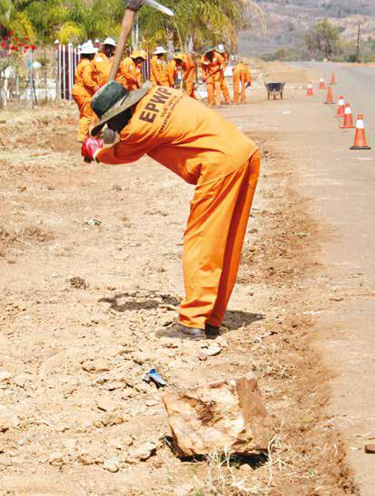

The instrument: Expanded Public Works Programme (EPWP) Policy, 2022 (GN 2505 in GG 46917 of 16 September 2022 – currently gazetted for public comments)
What is the EPWP?
Why are EPWPs important?

Slide 15
Basis in SA Constitution
The EPWP is a national development program; as such local government must, in terms of section 153(b) of the Constitution, participate in such programmes.
The EPWPs are potential vehicles for local governments to give priority to the basic needs of the community while promoting the socio-economic development of these communities.

Slide 16
Basis in local government and other law (legislation)
Local Government: Municipal Systems Act 32 of 2000
Section 23 of the MSA provides that a municipality must undertake developmentally-oriented planning to ensure that it –
(a) strives to achieve the objects of local government set out in section 152 of the Constitution;
(b) gives effect to its developmental duties as required by section 153 of the Constitution; and
(c) together with other organs of state contribute to the progressive realisation of the fundamental rights contained in sections 24, 25, 26, 27 and 29 of the Constitution.
The developmental role that the objective-driven programmatic approach used under EPWP has the potential to contribute to achieving the constitutional obligations as highlighted in section 23 of the MSA.
Additionally, the participatory role of local government stipulated under Section 153 (b) of the Constitution is further reiterated under Section 24(2) of the MSA requiring municipalities to participate in national and provincial development programmes.

Slide 17
Instrument objectives
The policy envisions the reconceptualisation of the EPWP to become an innovative public employment tool for South Africas Future. To achieve these ends, the policy plans to reposition the EPWPs to enable pathways into the labour market and social protection initiatives.
The advantage of these programmes for local government is that it creates a caring community dynamic involving persons from those communities in the local developmental dialogue and provides monetary relief for those gripped in the throes of poverty. This ultimately strengthens the interface between local government and communities and fosters increased community participation in local development planning.

Slide 18
Environmentally relevant features
The environment is an identified sector for the implementation of these programmes. The government funding that supports these programmes provides inter alia for training and enterprise development support for beneficiaries to develop skills while they gain experience and earn an income.
The mandate of the Department of Environment, Forestry and Fisheries is to ensure benefits from environmental assets that present opportunities to contribute significantly to job creation, social inclusion and the transition to a green, low-carbon economy and necessitates the implementation of environmental programmes that employ EPWP principles.

Slide 19
The responsible and accountable people
Depending on the type of EPWP, the role players may differ but may include the following persons within the local government structure:
EPWP Steering Committee
Which includes executive directors and line managers responsible for strategic direction; budget approval; reporting to EXCO; monitoring and evaluation
EPWP Sector Coordination and Implementation
Consists of project managers responsible for programme implementation, project design, reporting on EPWP system; sector coordination; adherence to budget and appointment quotes
EPWP Project leader
Responsible for checking the performance of the team on specific projects and verifying that planned work has been performed.
Local Reference Committees
Consists of various stakeholders in the community and is responsible for overseeing and providing support and guidance around the implementation of the programme.

Slide 20

Requirements for development and review
The EPWP is spearheaded by the Department of Public Works and Infrastructure however, the multi-disciplinary nature of these programmes requires input from different governmental departments across various sectors. Accordingly, the development and review processes of programmes under the instrument are fragmented, and a wide array of legislative considerations must be taken into account.

Slide 21

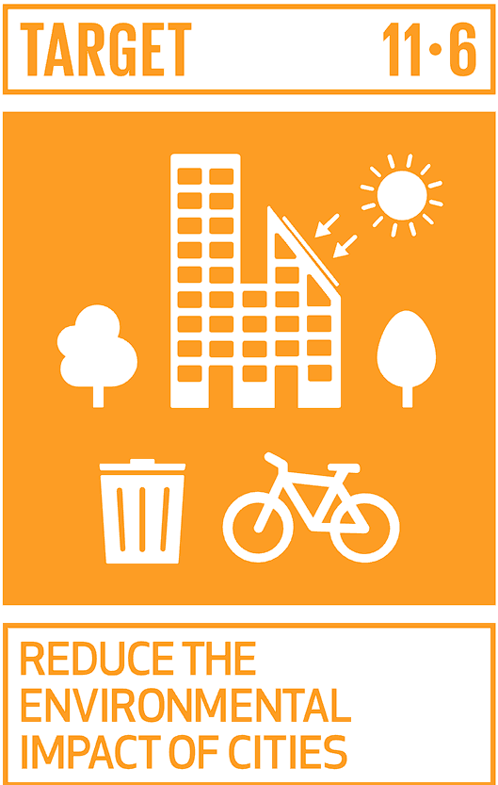
Linkages with Sustainable Development Goal 11
Changes in behaviour and attitude are essential considerations for the sustainability of human settlements. providing people with a sense of purpose can change their conditions and contribute to achieving SDG 11. The potential for EPWPs in the urban landscape is boundless and may possibly contribute to several of the targets of SDG 11, such as:
The four focus sectors of EPWPs include cultural heritage considerations and the promotion of tourism to highlight the country's cultural assets. In so doing, the EPWP can create both medium and long-term work and social benefits for the people of South Africa and those in communities surrounding these heritage sites. An example of this is the Social Responsibility Implementation Programme (SRIP) of the Department of Tourism which encompasses inter alia Heritage tourism projects and Nature-based tourism projects.
To by 2030 reduce the adverse per capita environmental impact of cities, including by paying particular attention to air quality and municipal and other waste management. EPWPs such as Working on Waste can contribute to the achievement of this target as the programme seeks to support the use of environmentally friendly waste disposal technology, Create sustainable livelihoods through recycling of waste (waste collection & minimisation), Promote environmental education and awareness to the communities especially as they are the main waste generators. Waste further has an impact on the ambient air quality within a specific area; the proper management thereof can lead to better air quality for those persons that may be affected.

Slide 22
Linkages with SA’s National Development Plan (NDP)
Chapter 11 of the NDP lays a clear vision as well as concrete policy business plans for a comprehensive social protection system for the country. Within the framework of an overall social protection system, the EPWP is positioned to assist in addressing a gap in the current social protection system by providing employment for those not covered by the social welfare system and who are willing and able to work.
The NDP emphasises: "The provision of Work Opportunities is one of the best forms of social protection". This is in line with the EPWP's current primary objective of providing work. Nonetheless, achieving stronger social protection outcomes has implications for four features of the EPWP and will require some modification in design, but more importantly, a stronger emphasis on implementation.

Slide 23
Linkages with SA’s Integrated Urban Development Framework (IUDF)
Policy lever 3: Integrated sustainable human settlements: community involvement in making their community sustainable is an important consideration of EPWP.
Policy lever 7: Empowered active communities: Government is already deeply committed to the co-production of various services at the local level, such as the Community Works Programme and the Extended Public Works Programme, that can contribute to the achievement of active citizenry.

Slide 24
What do the scholars in this field suggest?
Dladla L and Mutambara M "The Expanded Public Works Programme's Entrepreneurial Support Model in South Africa" 2022 New Innovations in Economics, Business and Management 67 – 78
According to the EPWP, the programme is defined as the nationwide government-led initiative with the objective of providing work opportunities and income support to poor and unemployed people over a short to medium term. It was introduced as a results of the Growth and Development Summit (2003), a conference representing labour, civil society, business and government led by National Economic Development and Labour Council (NEDLAC). During the Summit, a number of resolutions were taken and agreements reached including the implementation of the EPWP as poverty alleviation and income relief programme that provides a temporary work to the unemployed and ensuring that they participated in socially useful activities

Slide 25
Additional materials to consult
McCord A Public Works and Social Protection in sub-Saharan Africa: Do Public Works Work for the Poor? (United Nations University Press New York 2012)
Lotz-Sisitka H "Probing the Potential of Social Ecosystemic Skills Approaches for Green Skills Planning: Perspectives from Expanded Public Works Programme studies" in Rosenberg E, Ramsarup P and Lotz-Sisitka H (eds) Green Skills Research in South Africa (Routledge London 2019) 113-127
Baur P and Venter M "An Analysis of a Local Economic Development Strategy in the Arts and Culture Sector of the Expanded Public Works Programme Within South Africa" 2019 Journal of Public Administration 606 – 630
Melody R and Zonyana M "Local Economic Development: Exploring the Expanded Public Works Programme as an important tool and contributor to the City of Cape Town's Economic Growth Strategy" 2019 Skills@Work 20 – 44.
Glen N and Mearns KF "Expanded Public Works Programme Participants: Transitioning to Tourism in South Africa" 2021 Journal of Asian and African Studies 2014 - 2035
Baur P "The Impact of Minimum Wages in the Environment and Culture Sector of the Expanded Public Works Programme" 2020 African Journal of Employee Relations 1- 35

Slide 26
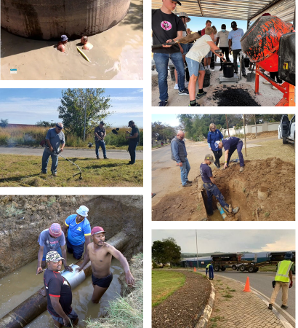
The instrument: active citizenship does not find its application in one specific instrument.
What is Active Citizenry?
Why is Active Citizenry important?

Slide 27
Basis in SA Constitution
Chapter 7 provides the constitutional foundation of local government.
Chapter 10, which speaks to public administration

Slide 28
Basis in local government and other law (legislation)
Local Government: Municipal Structures Act 117 of 1998
Local Government: Municipal Systems Act 32 of 2000
Local Government: Municipal Finance Management Act 56 Of 2003

Slide 29
Instrument objectives
Active citizenry seeks for local stakeholders, marginalised and excluded communities to be empowered through local government to become dynamic and equal participants in the processes which affect them.
collaborative approaches, including inter alia community development corporations, training and capacity-building initiatives, and value-adding initiatives can contribute to more active citizenry.

Slide 30
Environmentally relevant features
This approach necessitates that participation is taken a step further and has local stakeholders actively engage with environmental problems which affect them. Terms such as civic environmentalism, civic ecology and environmental stewardship fall within this realm of thinking and consider the rights of people and their concurrent duties and obligations to the natural world.
Activities surrounding environmental movements tend to promote local initiatives which are geared toward developing strategies for changing people's mindsets and circumstances. These movements often involve the mobilisation of specific communities that coordinate their activities against a specific planned development or environmental hazard.

Slide 31
The responsible and accountable people
The term 'local community' or 'community' is defined under Section 1 of the Local Government: Municipal Systems Act. These terms in relation to a municipality means that body of persons comprising:
(a) the residents of the municipality;
(b) the ratepayers of the municipality;
(c) any civic organisations and non-governmental, private sector or labour organisations or bodies which are involved in local affairs within the municipality; and
(d) visitors and other people residing outside the municipality who, because of their presence in the municipality, make use of services or facilities provided by the municipality, and includes, more specifically, the poor and other disadvantaged sections of such body of persons;
The above are all local stakeholders and have an essential role to play in the design, negotiation and implementation of initiatives to contribute to collaborative service delivery in municipalities.
From the side of the local government, several role players may be involved depending on the nature and duration of the specific collaborative initiative which is being undertaken. It should be determined through a consultative process with local government officials which department is responsible and which role players should be involved in the specific venture.

Slide 32
Requirements for development and review
There are currently no specific requirements for developing and reviewing the concept of active citizenry through collaborative service delivery.

Slide 33

Linkages with Sustainable Development Goal 11
Active citizenry through collaborative efforts can be viewed as a vehicle to achieve the overarching objective of Goal 11 of the SDGs to create inclusive, safe, resilient and sustainable human settlements. The array of service delivery mechanisms that local stakeholders can mobilise can have far-reaching implications for achieving this goal.
Many communities have taken on security initiatives such as a neighbourhood watch to make their communities safer. These organisations sometimes work closely with law enforcement and build networks of first responders through active participation in the well-being of their communities.
Tourism plays a critical role in many areas throughout South Africa, and local stakeholders' active involvement contributes significantly to this industry's success and sustainability. In many regions, community-based tourism provides residents with employment and helps them actively contribute to the local economy. Collaboration between municipalities and local stakeholders for conserving the country's cultural and natural heritage is vital as protecting these resources builds resilience in line with target 11.4.

Slide 34
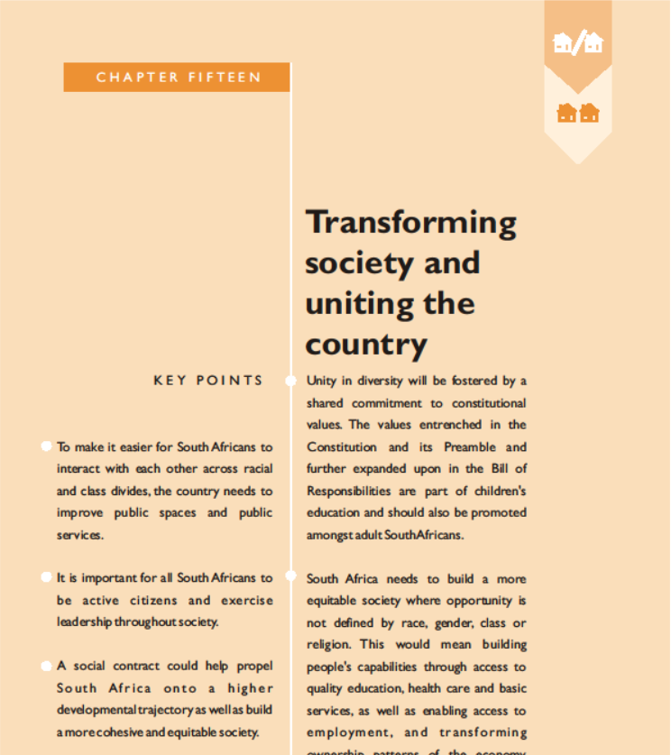
Linkages with SA’s National Development Plan (NDP)
Chapter 15 of the National Development Plan 2010 – 2030:
This chapter sets out the ways in which South Africa should transform as a society over the 20 years leading up to 2030.
The chapter emphasises that citizen participation has a vital role to play in bringing about transformation. It requires that all South Africans contribute and work towards realising the vision of a cohesive society.
The chapter provides that the philosophy of active citizenry requires inspiring leadership at various societal levels and that such leadership does not necessarily refer to individuals but could be collective leadership from communities.

Slide 35
Linkages with SA’s Integrated Urban Development Framework (IUDF)
Policy lever 7 of the IUDF emphasizes the need for empowered, active communities.
The premise of the policy level revolves around the assumption that citizens who feel good about where they live are more likely to take care of their neighbourhoods.
The policy lever acknowledges that human settlements can not succeed without the energy and investment of its citizens.
It further highlights public participation as it relates to decision-making as only the first step on the road to inclusivity and stipulates that the constitutional vision for local government requires active citizenry.
The IUDF provides that uplifting and empowering local stakeholders through active citizenry is a vehicle to enable human settlements to succeed and change the urban narrative of South Africa and improve the quality of life for communities.

Slide 36
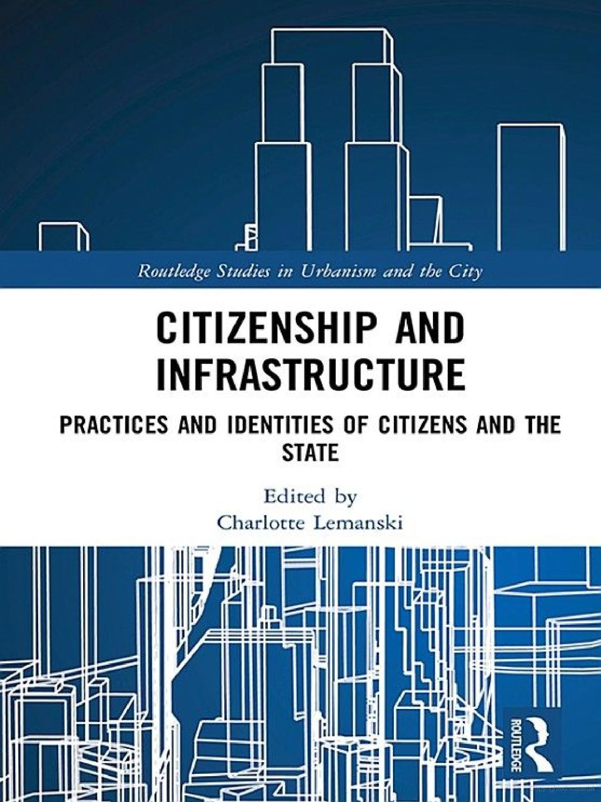
What do the scholars in this field suggest?
Lemanski C "Introduction: The Infrastructure of Citizenship" in Lemanski C (ed) Citizenship and Infrastructure Practices and Identities of Citizens and the State (Routledge New York 2019) 1-7
In this case, urban dwellers' political identity as a new citizen of South Africa is intertwined with physical receipt of public housing and associated services, whilst simultaneously the state conceives of its new citizens primarily as infrastructure consumers and/or complainers (rather than as active citizens per se). Consequently, citizenship as a political identity in the new South Africa is inherently about material identity in the sense of access to, and the quality of, public infrastructure.

Slide 37
Additional materials to consult
Gieseke TM Collaborative Environmental Governance Frameworks: A Practical Guide (CRC Press Boca Raton 2020)
Zondi W, Nzimakwe T and Mbili S "Evaluation of Service Delivery within Local Municipalities in South Africa" 2017 International Journal of Economic Perspectives 629-637
Packham C Active Citizenship and Community Learning (Learning Matters England 2008)
Hadjichambis AC and Reis P "Introduction to the Conceptualisation of Environmental Citizenship for Twenty-First-Century Education" in Hadjichambis AC et al (eds) Conceptualizing Environmental Citizenship for 21st Century Education (Springer Switzerland 2020)
Calzada I Smart City Citizenship (Elsevier Netherlands 2021)
Magidimisha HH and Chipungu L Spatial Planning in Service Delivery Towards Distributive Justice in South Africa (Springer Switzerland 2019)
Smith MJ and Pangsapa P Environment and Citizenship: Integrating Justice, Responsibility and Civic Engagement (Zed Books New York 2008)

Slide 38
The research for this presentation is based on research supported in part by the National Research Foundation of South Africa (Grant number: 115581) & the Konrad Adenauer Foundation (KAS).
All views and opinions are the author’s own.

